Slide 1

Practical Python For Modelers
J.D. Landgrebe
Data Delve LLC
version April 13, 2023

Slide 2
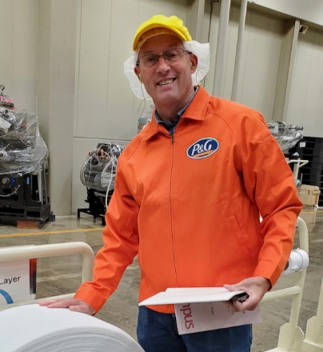


Workshop Leader Background: J.D. Landgrebe
34 years as Procter and Gamble R&D technologist
Material supply, consumer understanding, IP, R&D
Global Modeling Community
Training and mentoring
Chemical Engineering BS and MS
Aerosol Science Research and Publications – Particle Size Growth Modeling
Data science and technical modeling
Excel/VBA, JMP and Python software
Visualization, and design of experiments
PowerBI/DAX
Consulting Practice: datadelveengineer.com
LinkedIn www.linkedin.com/in/jdlandgrebe

Slide 3
Motivations/Insights– Do these Resonate?
Good collaboration on models depends on contributors having space within which to work and confidence in how to connect their work with others’
The right amount of code planning cuts down on rework and allows you to work with more complex topics
Picking a model back up from someone else (or from the one-year-ago you) can be challenging
Mostmodels don’t have an inspectable validation trail that that builds confidence in them as you work with them and seek to extend them

Slide 4

Takeaways For You From these Workshops
Learn an intuitive folder structure and associated code for curating and collaboration
Model connects naturally to needed data and *.py libraries
Toggle freely between test and “production” modes to encourage validation
Version control and ability to “use” a model while continuing to develop
Grow in your ability to architect your projects for personal efficiency and collaboration
Move to a modular, object-oriented approach (e.g. away from “spaghetti code”/rambling Jupyter scroll)
Learn Pytest and Test-Driven Development for validating models and data pipelines
Gain a planning template you can use to get organized
Insights (Definitions on next slide):
Lots of people talk about Object-Oriented Programming and TDD as separate topics. Nobody mentions how amazing they are together!!
Computer science basics are foreign to many/most engineers who code. That limits most corporate models

Slide 5
Nomenclature - Practical Definitions
Curating code and projects
Others and the future you can instantly know how a model works and how to dig deeper to get more info
The “new hire” test
Benchmark: no meeting needed with model owner/developer to get going with using and extending a model
Object-Oriented Programming (Wikipedia)
Self-contained Python class for each topic
Classes can be divided and worked on in separate files (and work divided among multiple collaborators)
Class __init__ function instances the class and documents the attributes (aka variables) for the work
Single-action class functions (aka “methods”) do the work
Jupyter procedural cells or class @property functions instance the classes and call functions to do the model’s work
Test-Driven Development (Wikipedia)
Use Pytest and test datasets to validate your code (coding consists of creating parallel test_xxx.py and xxx.py files)
Pre-write the test; Write simplest version of function that passes; Refactor to improve the code

Slide 6
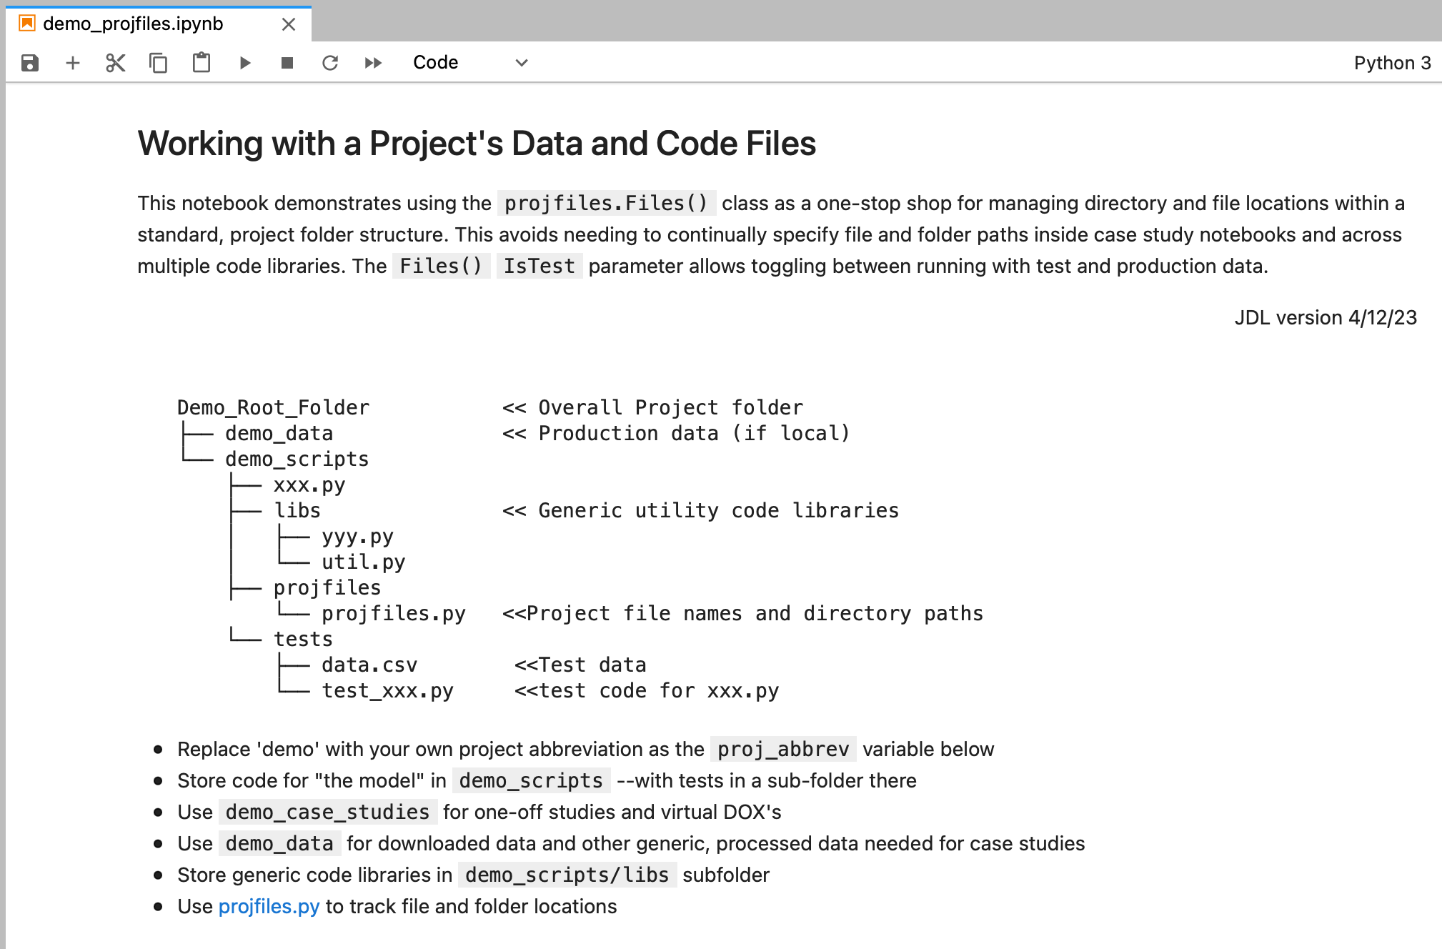
Keeping Track of A Project’s Files and Code
Open Jupyter Notebook Demo_Root_Folder/demo_analysis/_Dev_ThisProject/demo_projfiles.ipynb
The folder structure shows how to set things up for the model to be developed in a central place (demo_scripts)
_Dev_ThisProject folder represents the developer’s latest version. It has a Jupyter notebook as “dashboard” UI for running the model
Users can copy (and rename!) the _Dev_ThisProject folder and have instant access to latest version and connection to all data and scripts

Slide 7
Coding Architectures - Demos with proprietary client data
“Rambling Jupyter Scroll”
We all use them; Good for short, one-time analyses
Usefulness breaks down as complexity increases
Tough to develop in collaboration with others
Difficult to validate/test without immense clutter
Single-action Functions/”Procedures” that sequentially call functions
Functions are individually testable
Easy to develop and to view in-progress results
Difficult to systematically test especially in Jupyter notebooks
Object-oriented/Classes
Uses alternate ”self” syntax that takes getting used to
The open-source/developer savvy way to do it
Easy to access all attributes to debug and test
Fits naturally with validation by separate Pytest “tests” file

Slide 8
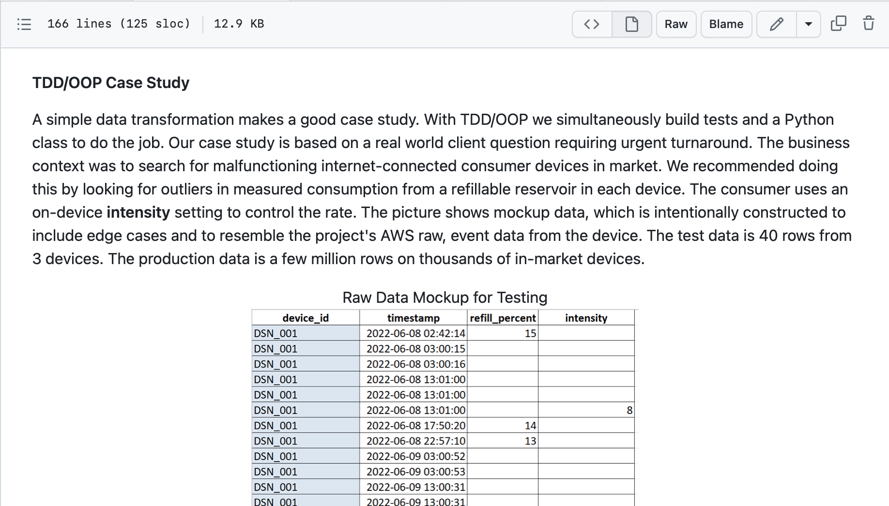
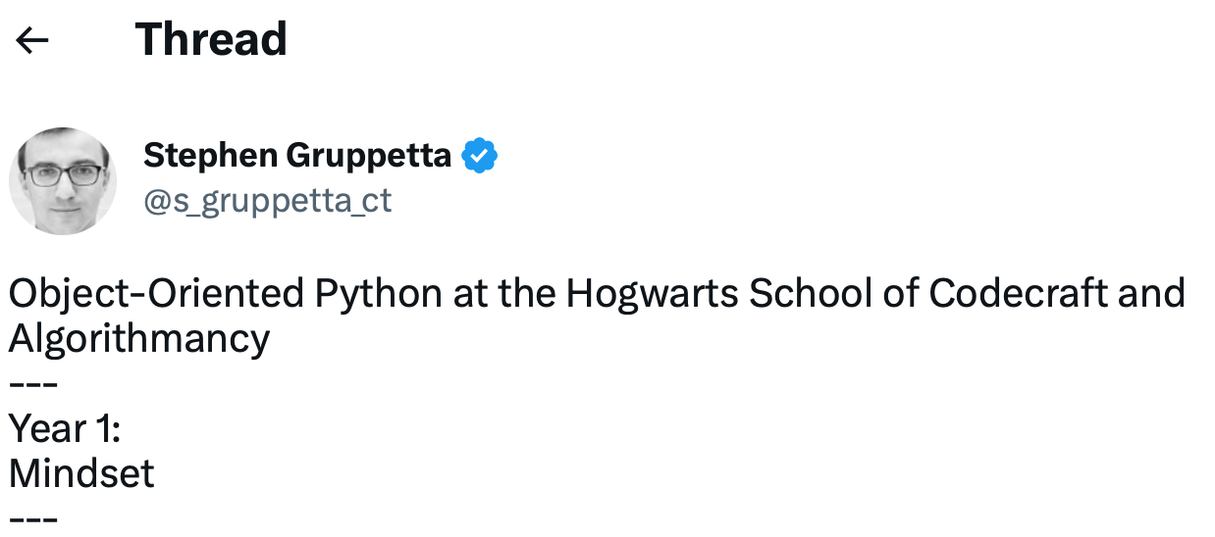
Getting Started with Python Classes And Testing
Homework for next time:
Download repository and review tutorial.md from TDD_OOP_Tutorial Github repo
Great Twitter thread by Stephen Gruppetta teaching Object-Oriented Programming.
Entitled, “Object-Oriented Python at the Hogwarts School of Codecraft and Algorithmancy” (he picked a theme and stuck with it…)
See his “Years” 1, 2 and 3 threads (4 through 7 are great but mostly beyond scope of what we will need and cover in next session)
Year 1
Year 2
Year 3

Slide 9
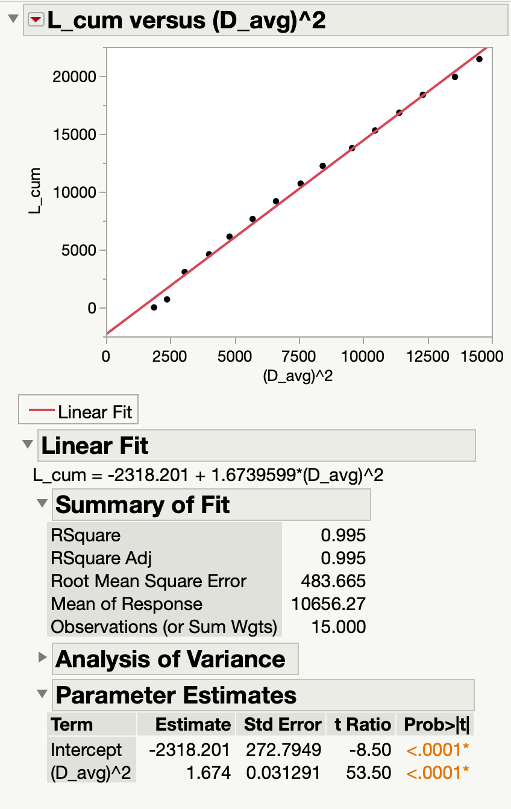
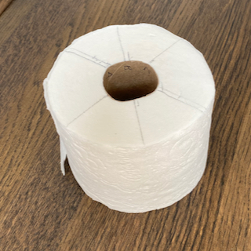
Example Model for Learning ”TuhDooP”
Model is a teaching case study in Digital Transformation with Excel Online Course
We can use its raw and transformed data for validating a Python version
Roll Length Model.xlsx - Toilet paper example
Technical model to calculate length of substrate on a roll based on diameter
Model is industrially useful in R&D and manufacturing settings
Example raw data and equation derivation available as background in file
Transformed/Linearized

